Slide 1

Presentation on Micro Project “PEER TO PEER NETWORK CONNECTION”
By
BHAWAR RUTUJA 12
GADEKAR PRATIK 20
GUGALE MANSI 24
PALSAPURE RADHIKA 44
RAJPUT JANHAVI 50
Guided by
PROF. SUPRIYA MHASKE
Department of Computer Technology ,Government Polytechnic Ahmednagar

Slide 2
Index
Problem Statement
Motivation
Objectives
Methodology/ Proposed system block diagram
Tools and Technologies
Implementation
Results
Challenges faced
Conclusion and Future Scope

Slide 3
Problem Statement
To study the peer to peer network connection and share the resources and help computers or devices work collaboratively provide specific services to execute specific task.

Slide 4
Motivation
Peer to peer networking has several benefits. For one, your computers can share data with each other effortlessly. They can also share common devices, like printers and CD ROMs, or even hard drives. The data can be shared in both directions quickly, without the need for routing through another computer .
A major benefit of peer to peer network is that the lack of a centralized server reduces bottlenecks. If you take a client server model, sometimes the servers handling the communication get clogged up. They get a large number of requests from clients, more than the processor can handle.
They get clogged up and the communication slows down to a crawl. Sometimes the servers crash, and the communication stops entirely. This is a common occurrence on the internet, when a website server gets more traffic than it can handle. This is not a problem with peer to peer networking, as the network members communicate directly with each other.
Even at peak activity, peer to peer networks run efficiently. Bottlenecks, if they form, can be easily resolved too.

Slide 5
Objectives
To study and implement peer to peer network connection to achieving this aim , the following specific objectives are as follows
enable communication between two or more computers on the network
Allow the computers in the network communicate without the need for a central server
Allow the computers connected in the network to perform the function of both server and client on the network that is they are given the administrative rights to both send and receive the data
Create a network for each computer to easily upload and download files over peer to peer network, and this can be done without having access of internet.

Slide 6
Methodology/Proposed System block diagram
Peer-to-peer networking is an approach to computer networking in which all computers share equivalent responsibility for processing data.
Peer-to-peer networking differs from client-server networking, where specific devices have responsibility for providing or serving data, and other devices consume or otherwise act as clients of those servers.
Individual users have responsibility over who can access data
and resources on their computers.
Operating systems such as Windows XP and Windows Vista allow accounts to be set up that will be used when other users connect to an individual user's computer.

Slide 7
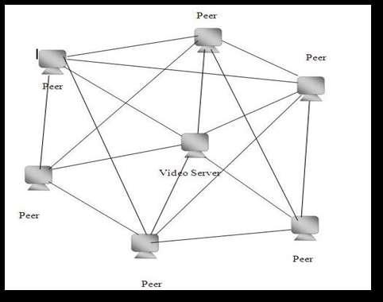
• Accounts, passwords, and permissions are saved in a local database and are used to determine what someone can do when connecting to your computer.

Slide 8
Tools and Technologies Used
Computer:- Software for peer-to-peer network is included with most modern desktop operating systems such as Windows and Mac OS. Peer to peer relationship is suitable for small networks having less than 10 computers on a single LAN
Cable:-In peer-to-peer network models, all the computers are connected to each other, either via USB or Ethernet cables.

Slide 9
Implementation

Slide 10
Challenges Faced
Unreliable, low uptime, low capacity, low bandwidth connection between nodes, nodes vulnerable to data and routing manipulation and monitoring, no access to nodes for the operator, nodes as part of the infrastructure are accessible by the user.
Security: As parts of the p2p infrastructure are accessible to everyone a different security philosophy is required, to protect against data and routing manipulation (e.g. Sybil attacks).
Privacy: To protect privacy despite the fact that it is stored on unreliable nodes, data needs to be encrypted all the time, possibly using fully homomorphic encryption .
Limited bandwidth: the bandwidth between nodes limited, opposite to high bandwidth connections within a data center. This requires specific algorithms.

Slide 11
Conclusion and Future Scope

Slide 12
References
https://www.geeksforgeeks.org/what-is-p2ppeer-to-peer-process
https://ieeexplore.ieee.org/document/1665164
https://link.springer.com/refer
https://en.wikipedia.org/wiki/Peer-to
https://en.wikipedia.org/wiki/Peer

Slide 13
Results

Slide 14
Thank You

